Slide 1
PREDICTION CUSTOMER
Customer booking

Slide 2
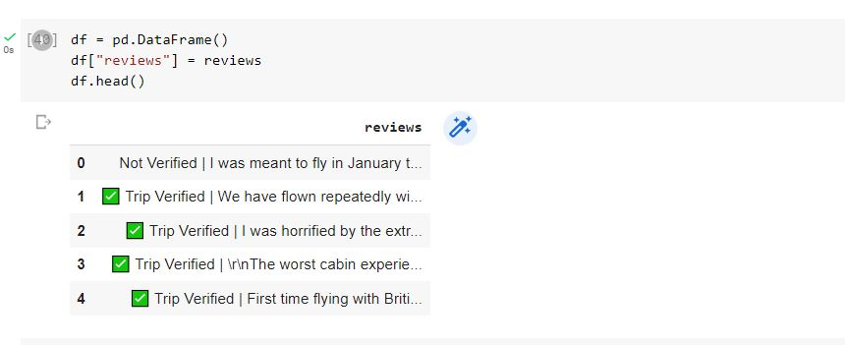
Collecting 1000 reviews

Slide 3
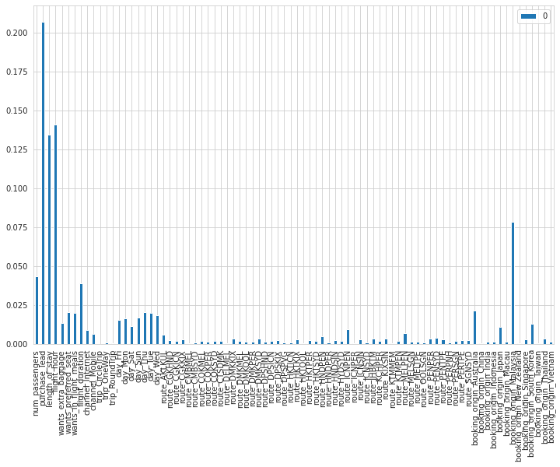
Features important

Slide 4
Evaluation
• The most important variable in the model was purchase_lead, that is the time between purchase and departure.
• Information about the flight, e.g. flight time and duration was also significant, however booking origin of the customer was not important.
• The accuracy of the model was approximately 0.90 (Precision) and 0.50 (Recall), showing that this model requires more improvement.

